Slide 1
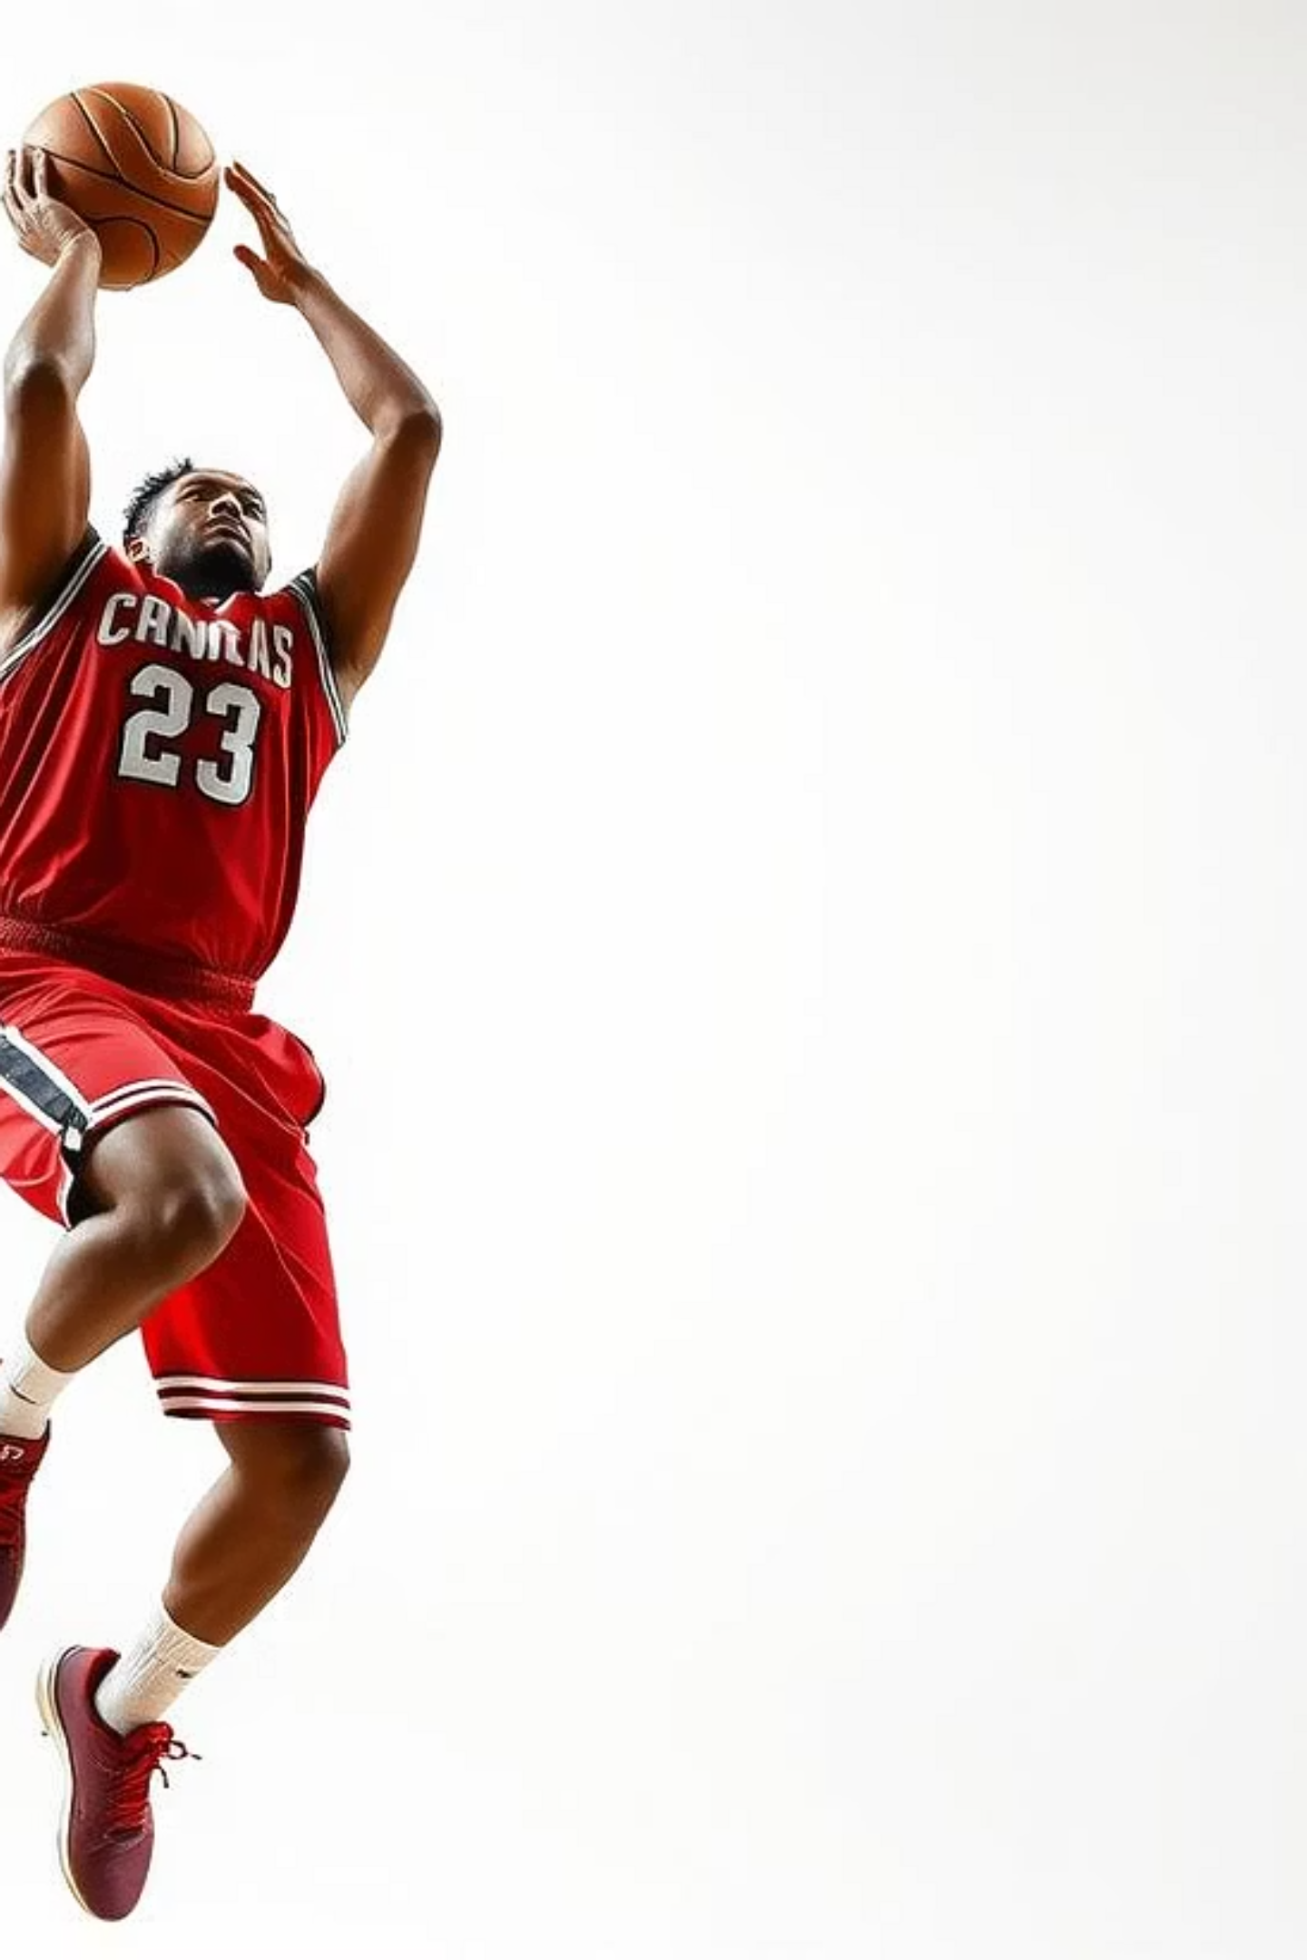
SwishSensei: Sensor-Based Basketball Shot and Jump Analyzer
Welcome to our final presentation for the IoT Course. Today, we'll introduce SwishSensei, a groundbreaking project designed to revolutionize basketball training.

Slide 2
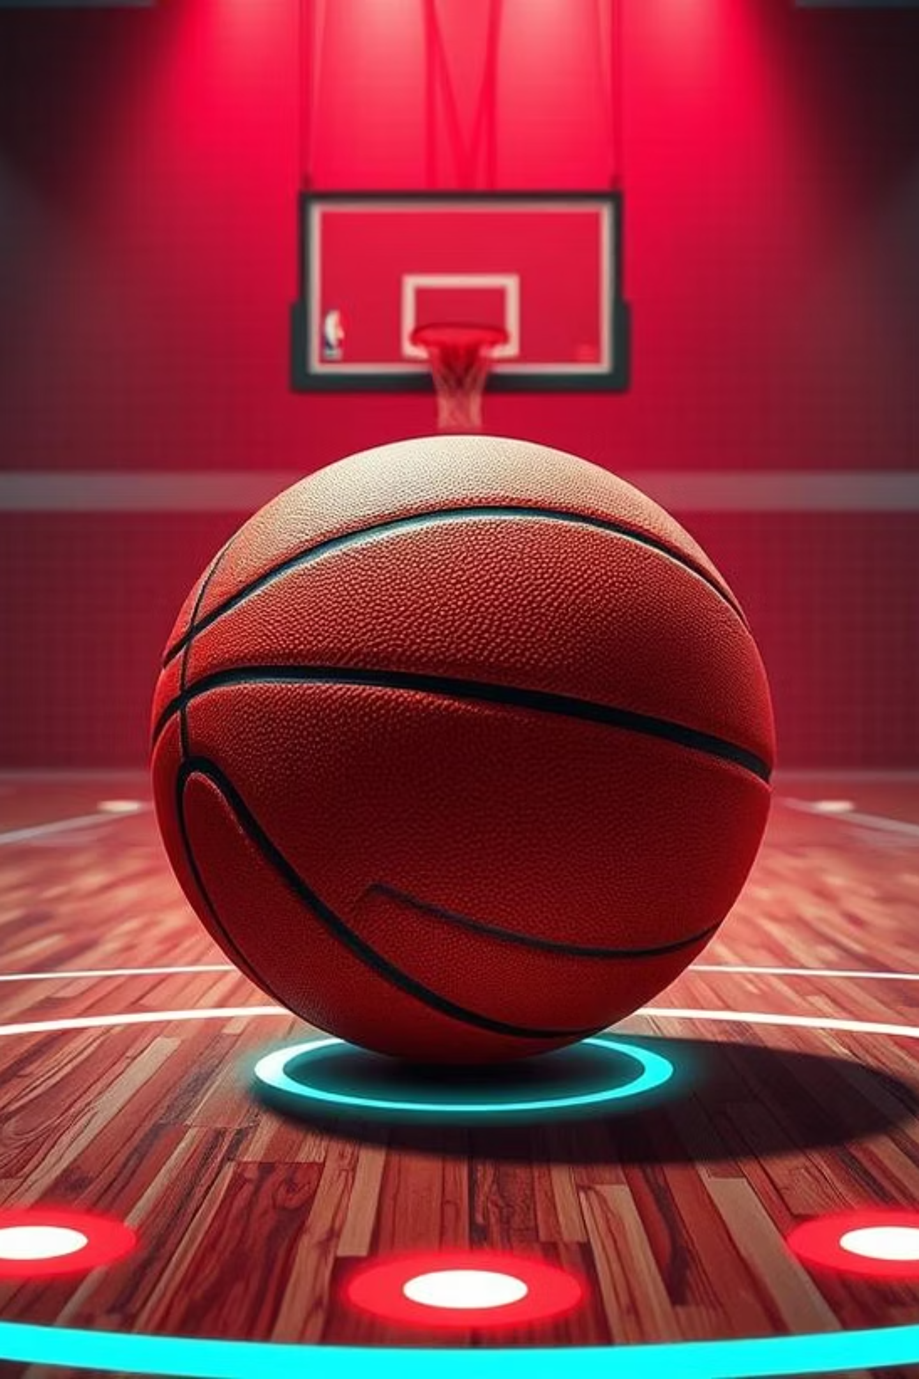
SwishSensei: Sensor-Based Basketball Shot and Jump Analyzer
Final Presentation for IoT Course
Team Members: Omar Sherbini, Abdul Wassey Date: July 9, 2025

Slide 3
Motivation
As a group of sports enthusiasts and tech learners, the team combined their passion for basketball and technology to create SwishSensei, an IoT-based analytics tool. Motivated by common challenges players face—like proper wrist and finger use for shooting and jump mechanics—they aimed to use sensors to analyze these movements. The project started with collecting and interpreting sensor data, with a vision to evolve into a smarter system by integrating cameras, AI, and computer vision. Their ultimate goal is a portable, intelligent training assistant for basketball players

Slide 4
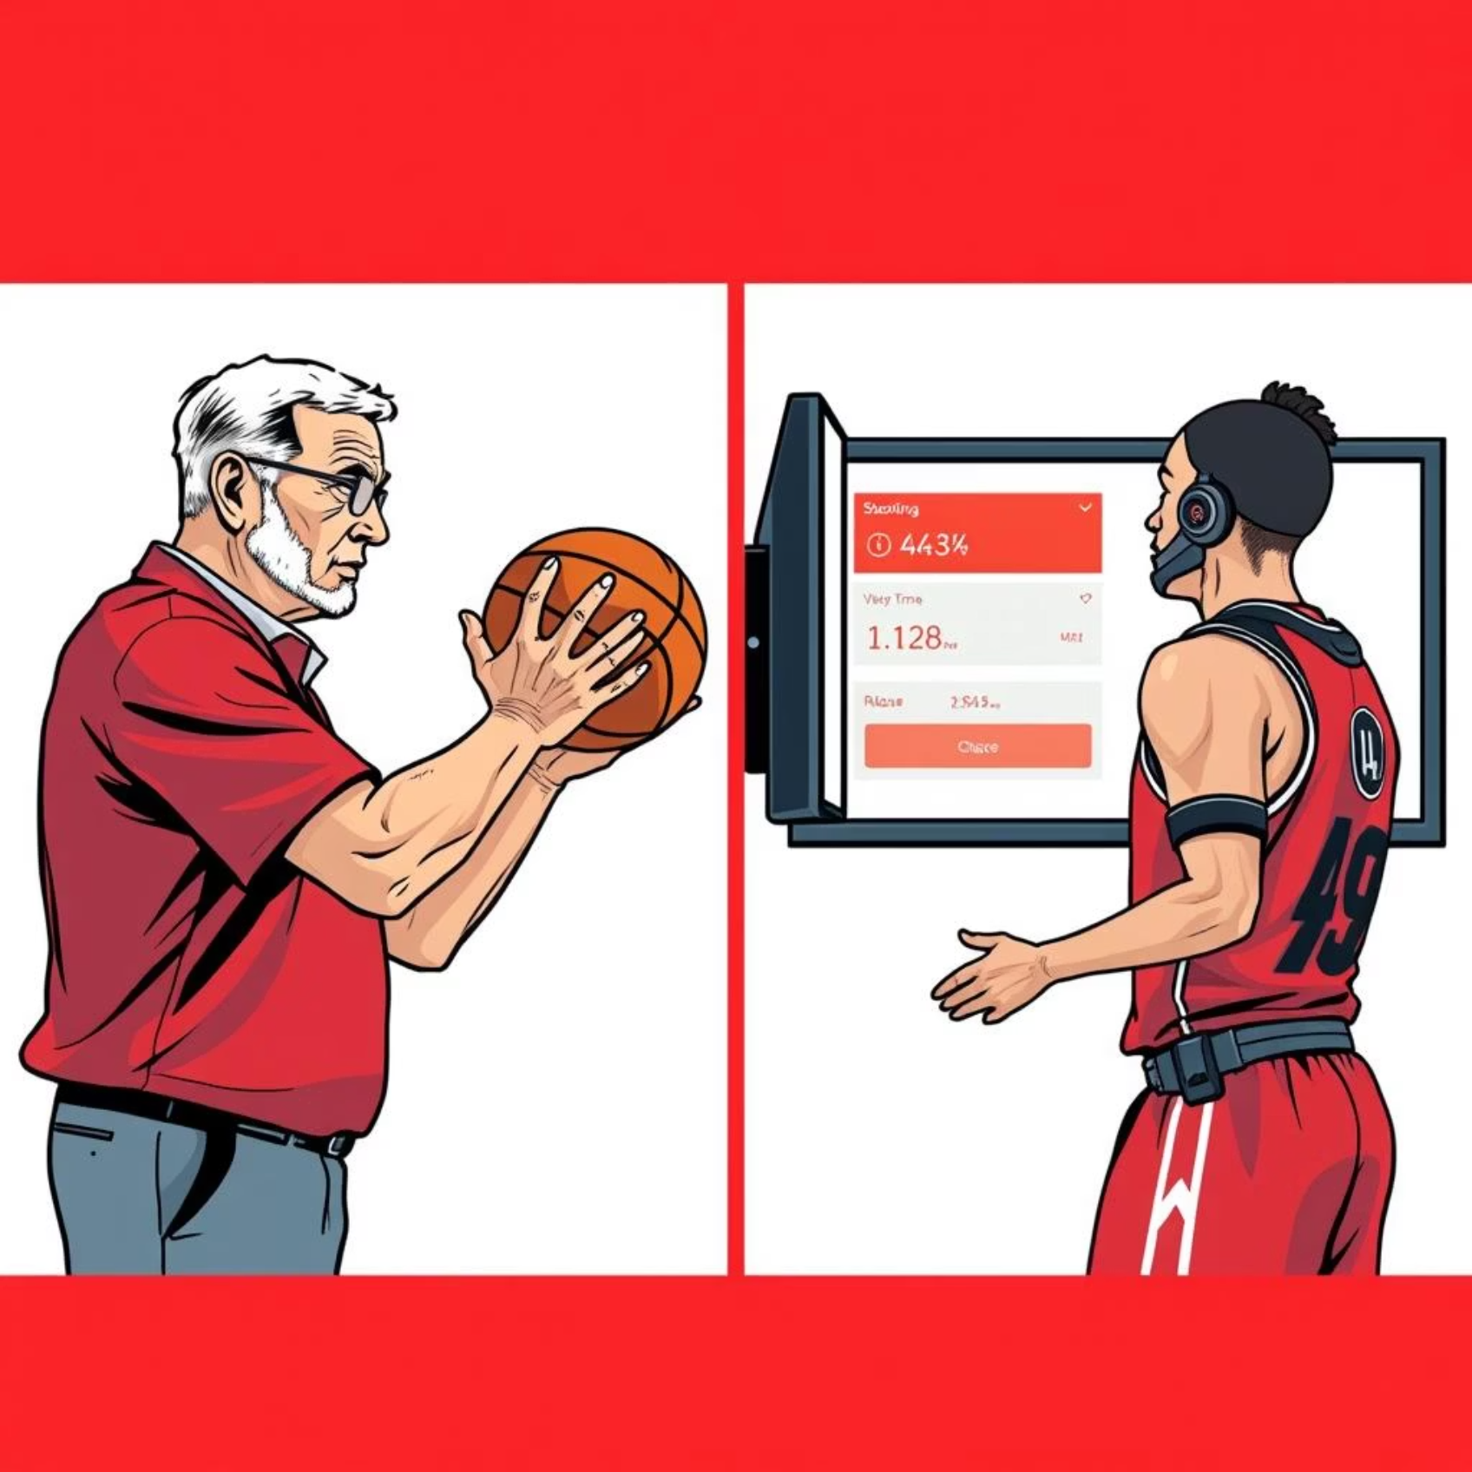
The Problem That Needed to Be Solved
Improving basketball mechanics is challenging. Many players struggle with:
Difficulty in refining shooting form and jump mechanics.
Lack of accessible tools for real-time, objective feedback.
Heavy reliance on subjective video analysis or human coaches.

Slide 5




Use Cases for SwishSensei
Solo Training
Real-time Feedback
Players can train effectively without direct coach supervision.
Instant insights on performance during practice sessions.
Post-Session Analysis
Detailed Insights
Detailed reports to pinpoint strengths and areas for improvement.
Metrics on jump height, balance, wrist motion, and finger pressure.

Slide 6
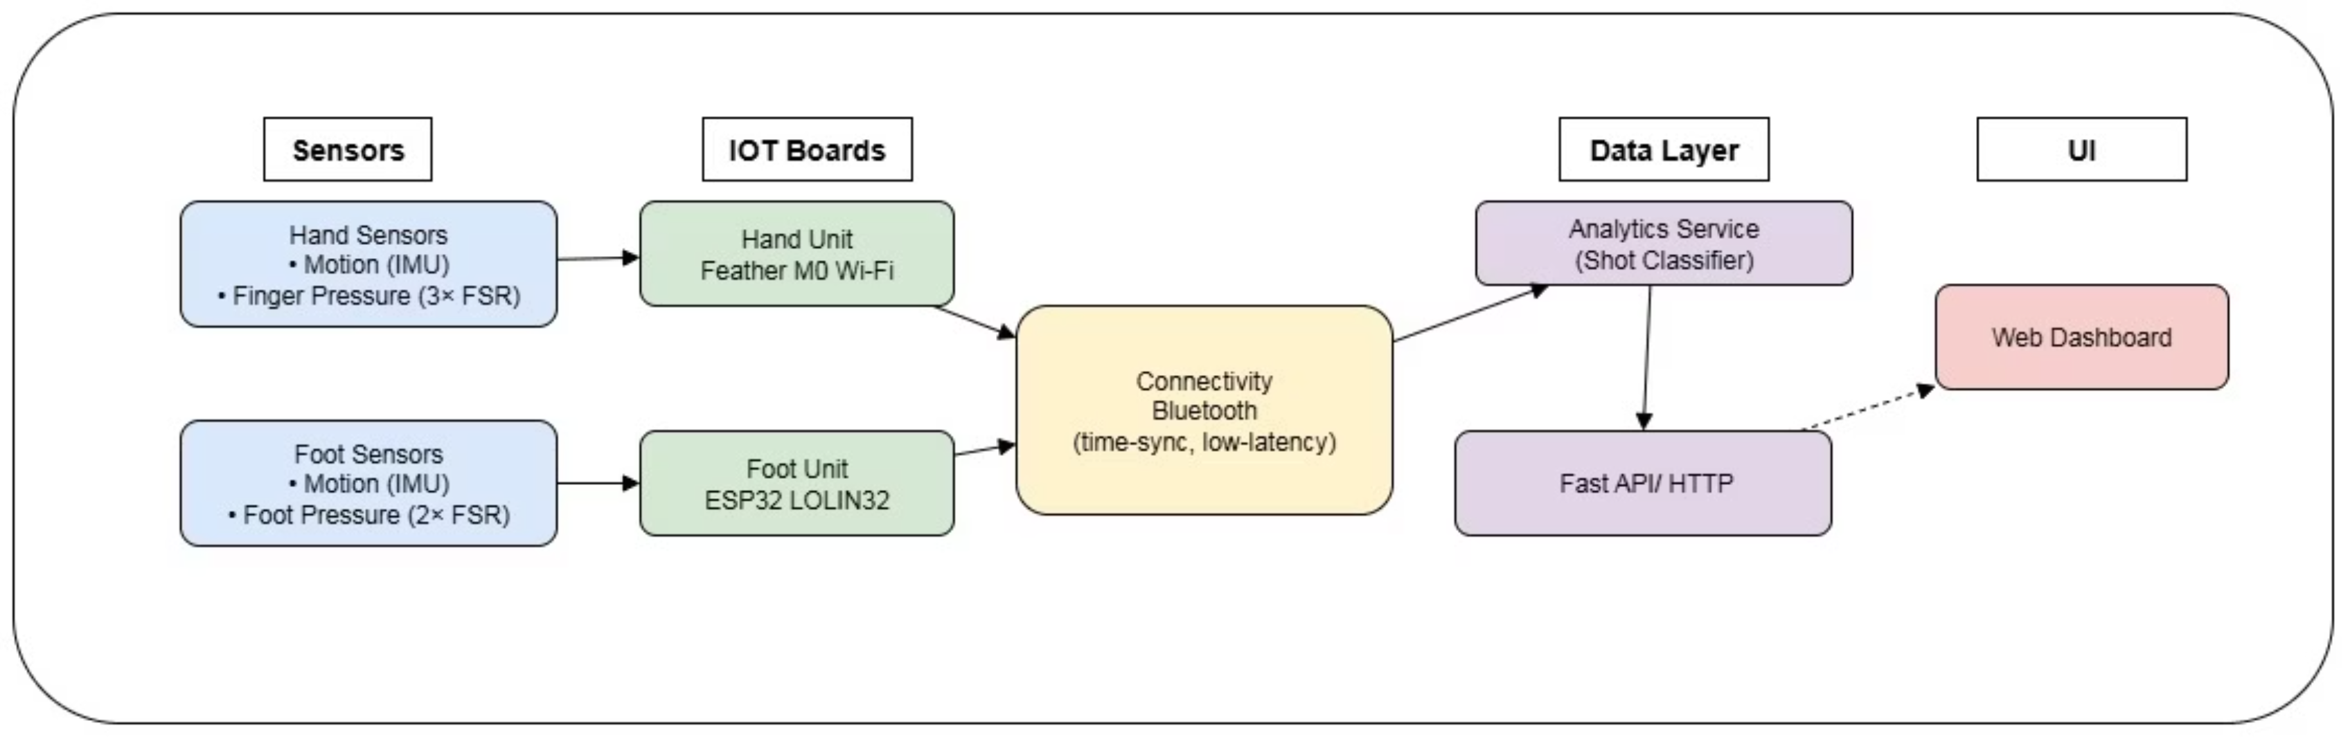
System Architecture
SwishSensei leverages a robust architecture for data collection and analysis:
Things: Custom ESP32-based sensors for foot pressure and hand mechanics. Using MPU-6050 and force resistance sensors
Connectivity: BLE client streams sensor data to a backend server.
Analytics: Backend algorithms classify shot timing and calculate precise jump metrics and also give raw data

Slide 7
Challenges and Solutions
Category
Challenge
Solution
Things
Ensuring accurate sensor data collection.
Calibrating FSRs and MPU6050 for real-world scenarios.
Connectivity
Maintaining reliable BLE connections.
Implementing robust error handling and reconnection logic.
Data
Managing large volumes of raw sensor data efficiently.
Optimized backend and frontend for high-performance data storage.
Analytics
Developing intuitive metrics for shot and jump quality.
Physics-based algorithms for jump height, wrist motion classification.

Slide 8
Implementation Details
Hardware Integration
Data Streaming
ESP32 microcontrollers gather precise foot pressure from FSRs and wrist motion data from MPU6050s.
BLE client streams real-time JSON events to a FastAPI backend for processing.
Algorithmic Core
Custom algorithms classify shot timing phases and calculate force put on the ball using the hand.

Slide 9
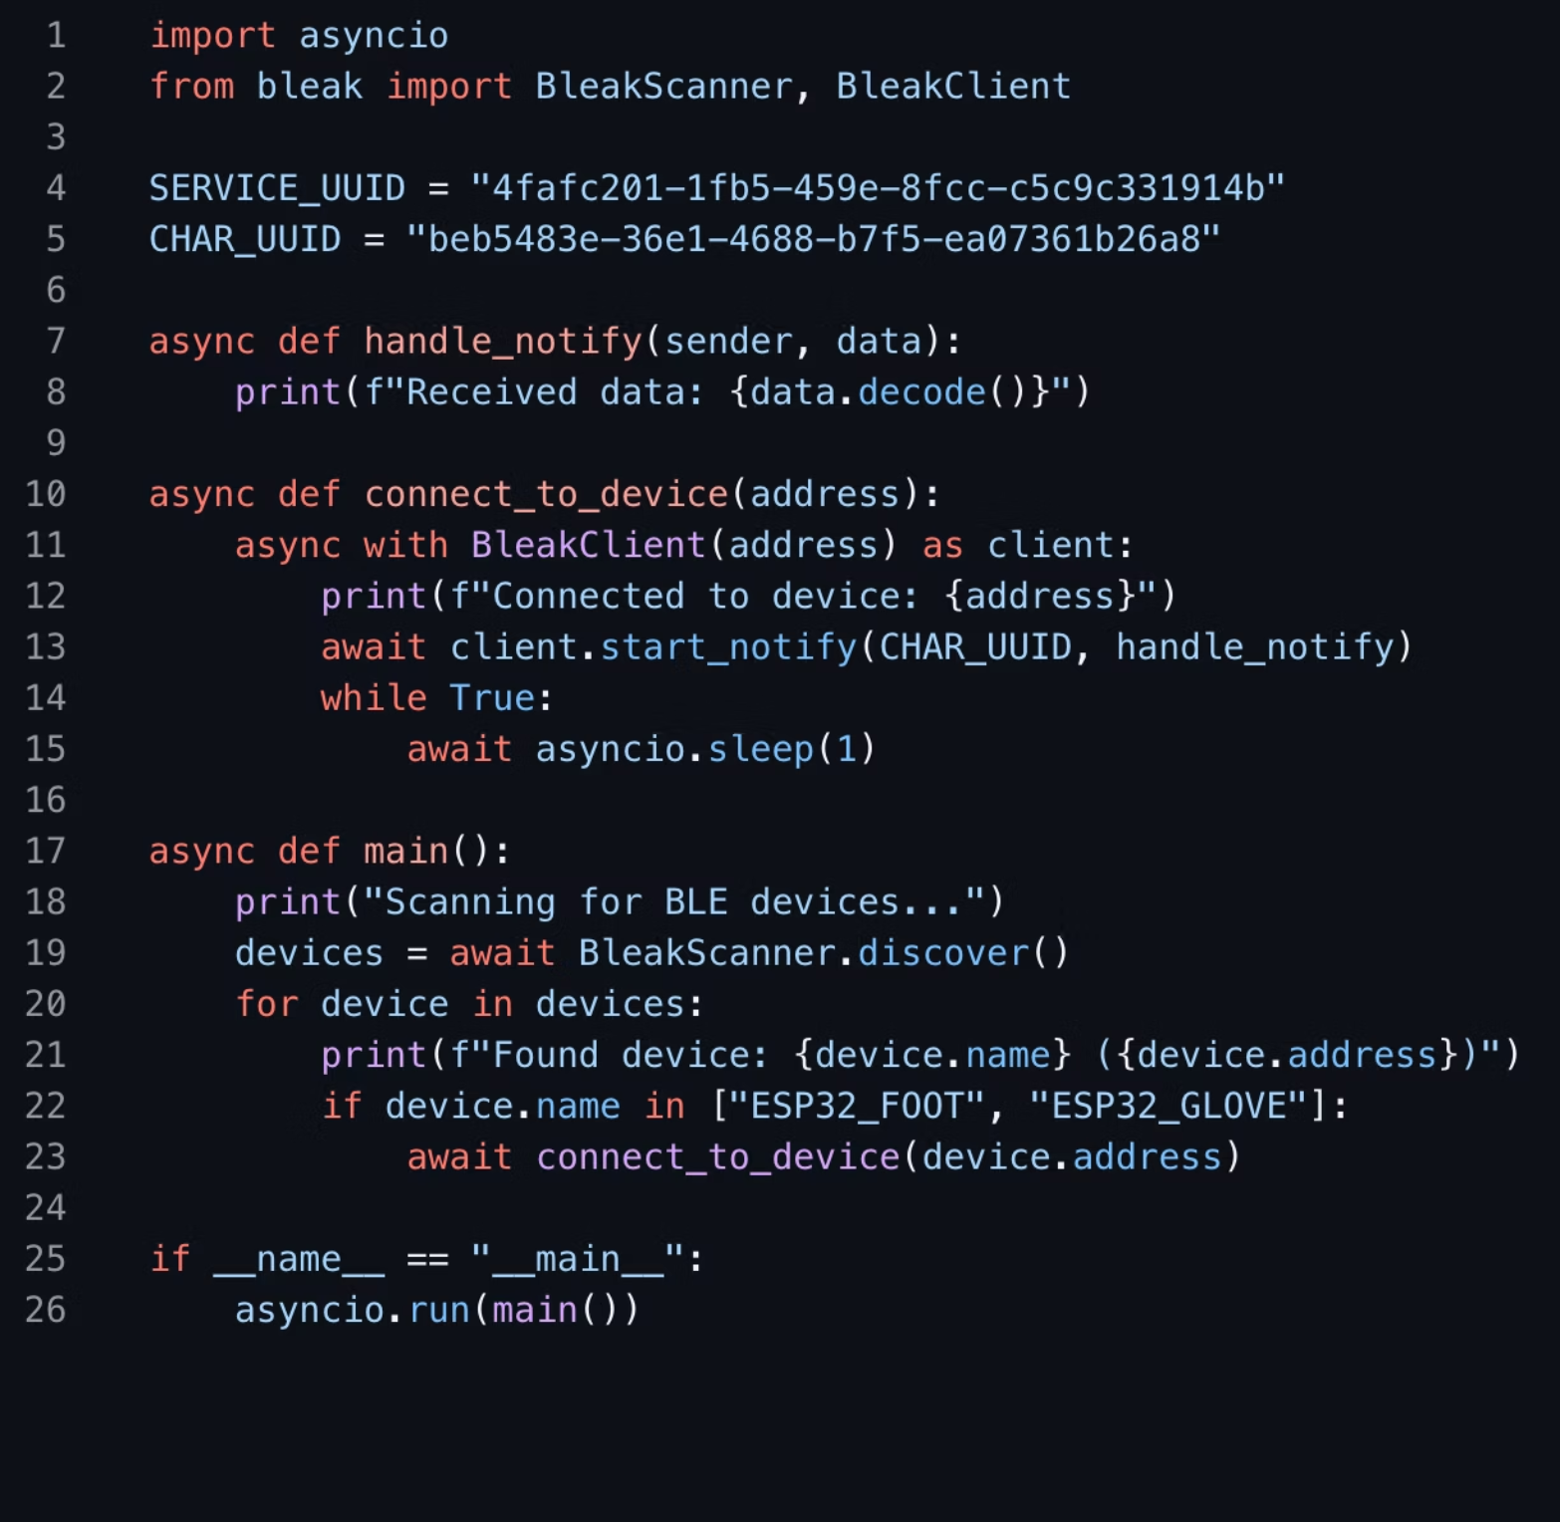
Explanation of Key Code Sections
BLE Client
Code for scanning, connecting, and managing data streams from multiple sensors.

Slide 10
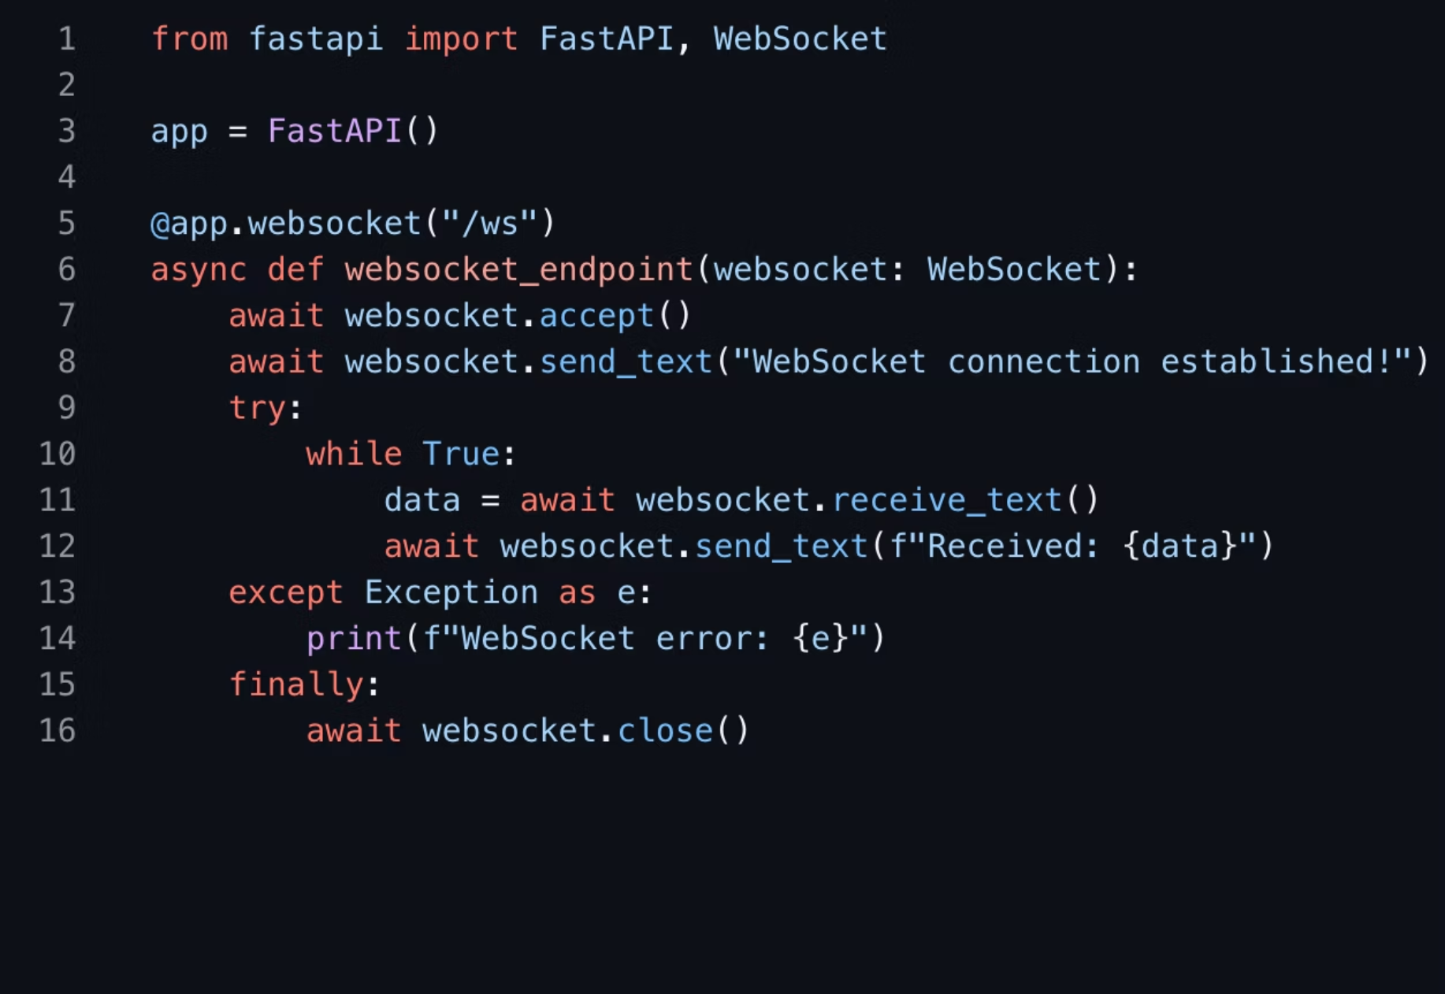
Explanation of Key Code Sections
WebSocket Implementation
Enabling real-time communication for live dashboard updates.

Slide 11
Live Demonstration
We're excited to showcase SwishSensei in action!

Slide 12
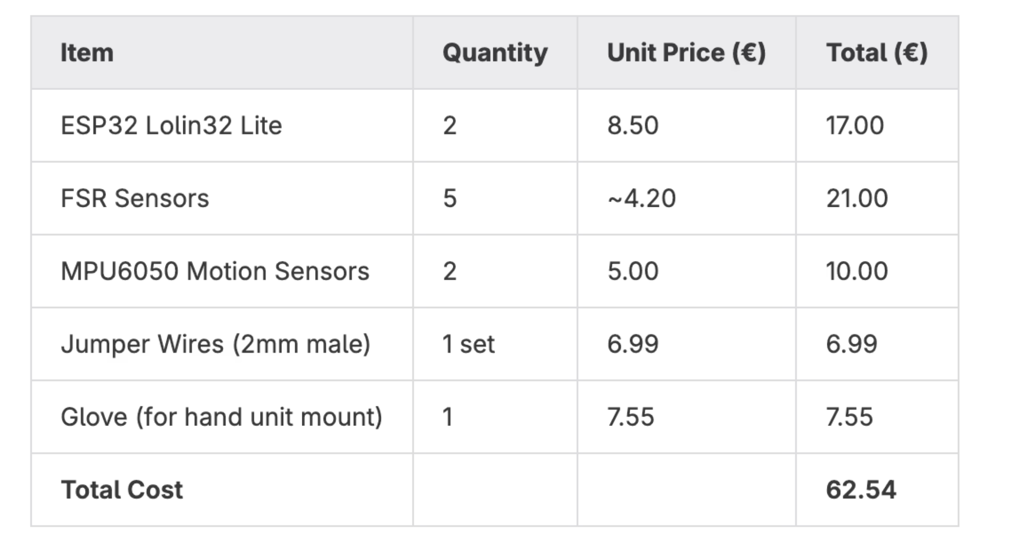
Cost and Hardware breakdown

Slide 13
Future development
ML-Based Shot Analysis: Train models on sub-second motion and pressure data to detect form issues like early jumps, weak follow-through, or lack of backspin.
Mobile App with Live Feedback: Build a companion app to display real-time shot diagnostics and suggestions over Bluetooth.
Session-Based Analytics: Visualize player trends over time (accuracy, jump consistency, balance) to track improvement.
Shot Type & Distance Recognition: Automatically classify free throws, mid-range, and 3-pointers based on timing, force, and motion profiles.

Slide 14
Q & A

